Slide 1

Power electronics for TOMORROW’s industries
Automotive, Renewable Energy, IT & high tech and more

Slide 2

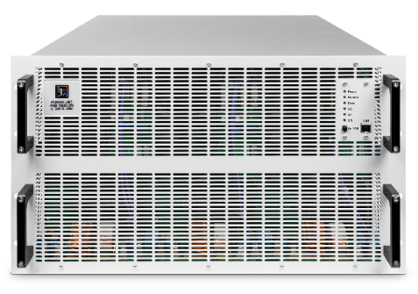
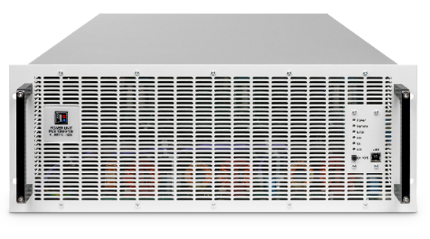
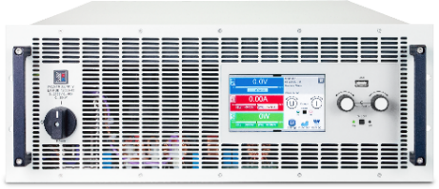
EA Elektro-Automatik
Innovation & quality since more than 40 years
Europe‘s leading manufacturer of power electronics for research and development as well as industrial applications
Founded in 1974
More than 350 employees
Production location in Germany (19.000m²)

Slide 3
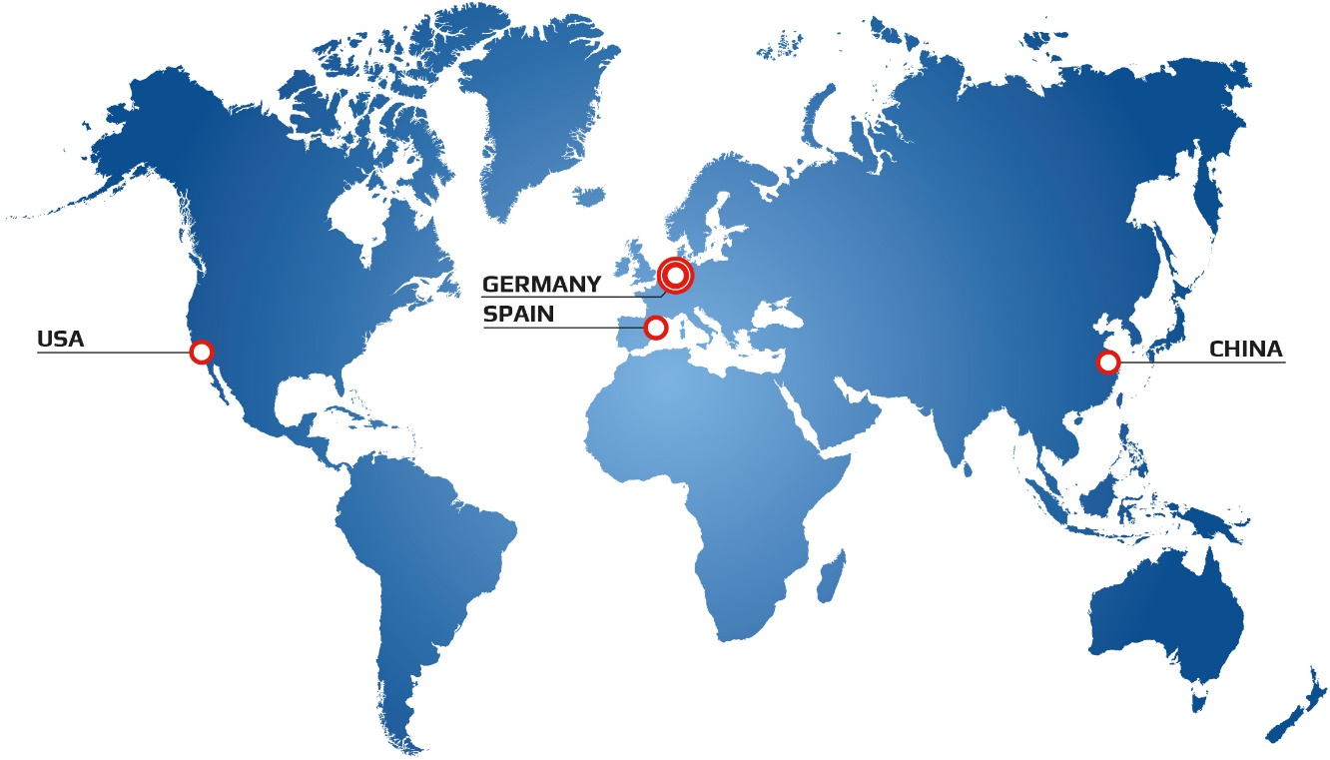
GloBAL OPERATION
World-wide near out customers
Headquarter in Germany (Viersen, NRW)
Branches in China and USA
Sales office in Spain
Worldwide network of partners

Slide 4

ReSPONSIBILITY For people & ENVIRONMENT
Value oriented business culture
Respect in dealing with employees, customers and partners
Investment in training and continued development
Engagement in conservation of natural resources
Optimal energy efficiency in production and products
Green Loads: regenerative generation of power and loads

Slide 5

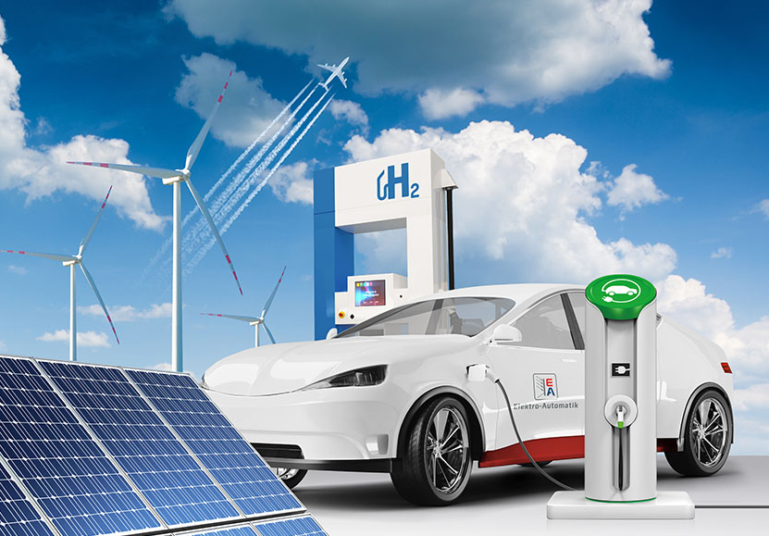
POWER SUPPLies &
ELECTRONIC LOADS
Serving the industries of the future
Research, Industry and Training
Future industries, e.g.:
Automotive and Electromobility
Renewable energy
Electrochemicals
Process technology
Telecommunication & IT

Slide 6
OUR STRENGTHS
PRODUCT
DEVELOPMENT
Short development cycles
for new devices
A summary view
SPEED
Short paths and
quick reaction time
PRODUCTION
at a high technical level
EXPERIENCE /
KNOW-HOW
Long term experience, knowledge and a progressive way of working
QualitY management
High quality and
absolute reliability
INNOVATIVE STRENGTH
New ideas and visions for the products of the future

Slide 7
THE HIGHEST PERFORMANCE RANGE ON THE MARKET
Efficiency improvement
Product benefits
Advantage for the user
Highest performance range in the market
Optimal energy usage
Regenerative power feedback
High functionality and flexibility
Efficiency improvement
Workflow optimisation
Reduction in operating costs

Slide 8

INNOVATION AS A TRADITION
Research & Development of new technologies
Pioneering new technologies:
Introduction of flexible output power stages for laboratory mains supplies (autoranging output)
Regenerative power with electronic loads
Development of intuitive colour TFT displays

Slide 9
PERFORMANCE ELECTRONICS Made in Germany
With high depth of manufacture and state-of-the-art methods
Manufacture
Depth of manufacture
Production approx. 19.000 m²
State-of-the-art methods and high quality standards from goods-in through production up to final control and quality tests
In-house assembly of core products with electronic components

Slide 10
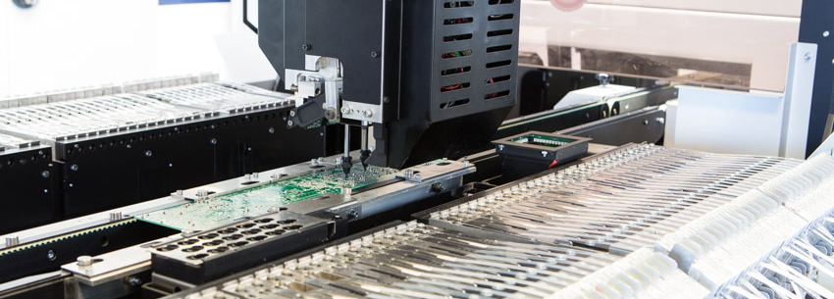
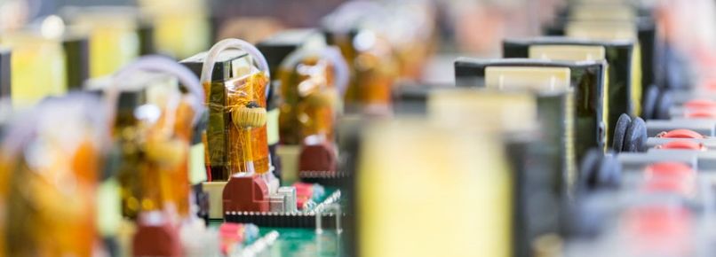
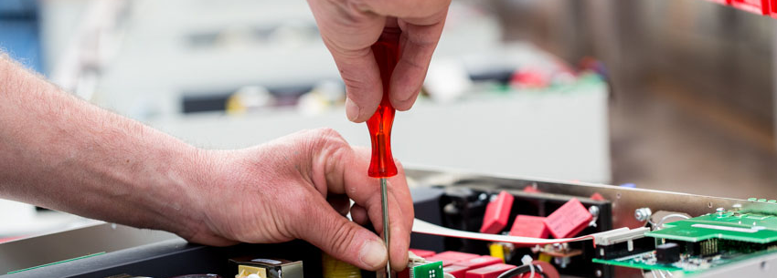
CIRCUIT BOARD PRODUCTION AND ASSEMBLY
Operating with the most modern assembly- and soldering equipment
SMD-Assembly
(Surface Mounted Device)
THT-Assembly
(Through Hole Technology)
Device assembly
Machine supported assembly of the components
For circuit boards of a high manufacturing quality
Lead-free soldering under nitrogen
For high precision soldering joints
Configuration of all components into a finished device

Slide 11
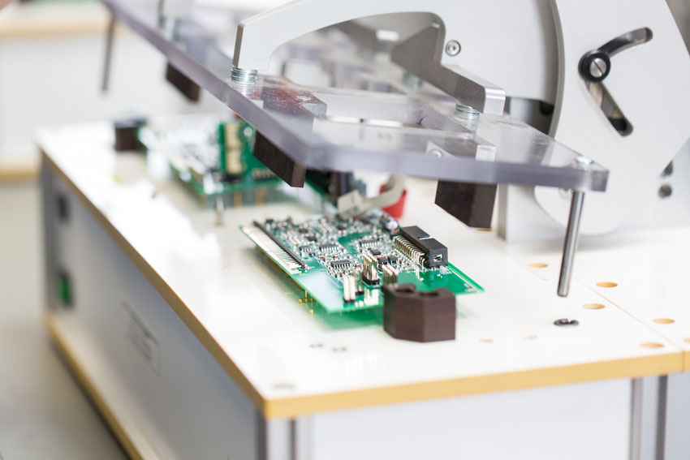
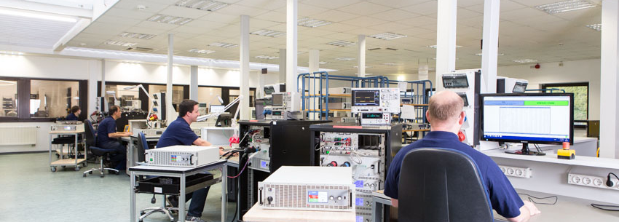
Computer aided test procedures
Automated test systems for quality assurance
Sub-assembly testing
Device testing
Testing the circuit boards for funtional conformance
With computer aided systems
Highest confidence level for users
Five computer controlled test steps before shipment

Slide 12

Just for internal use
RefereNCES
Satisfied customers from many branches

Slide 13
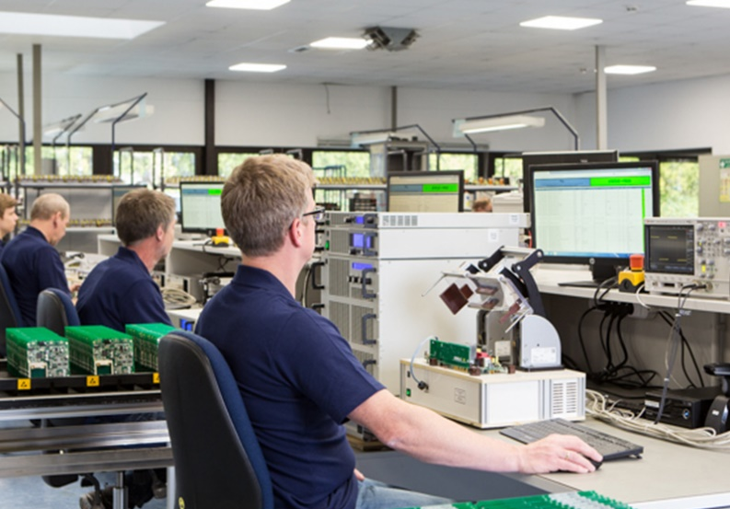
GPI-Concept
Minimum dimensions for maximum efficiency
General Purpose Instrument
Designed to power a maximum number of EUTs (equipment under test) with a minimum number of devices

Slide 14

Tailored product performance
Modular, scalable updateable
Modular architecture / scalable performance
Tailored performance
In small, medium and high power of up to 30kW per block
Possibility to systematically extend power
Automatic Updates
Update-capability of the processor units
User functionality is always up-to-date

Slide 15
Programmable DC power supplies
For training, workshops and laboratory application
With autoranging output (flexible output power stage)
For supplying many EUTs* with differing nominal voltages
Optimal combination of analogue and digital methods (μ-contoller / FPGA based)
Desktop, tower style or 19“ rackmount
*EUT = Equipment under test

Slide 16
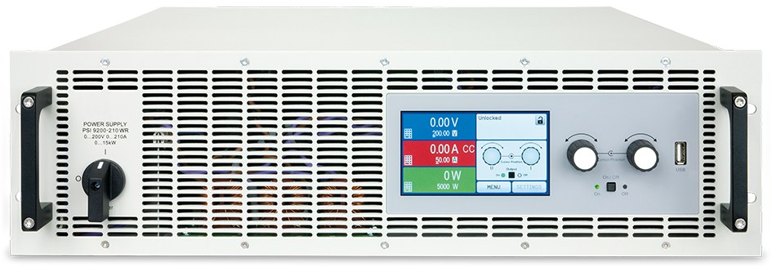
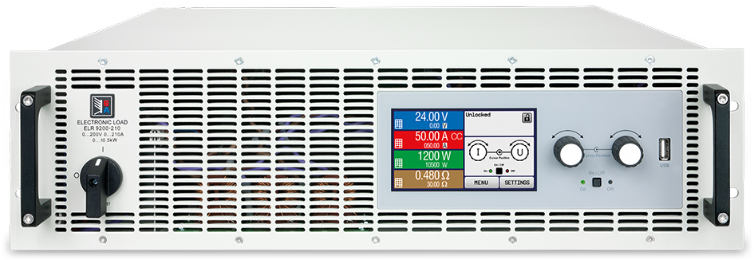
Programmable DC Electronic Loads
For industry, research and development, conventional and regenerative technology
Optimal combination of analogue and digital circuitry (μ-contoller / FPGA based)
Based on few standardised electronic platform
Conventional technology & Regenerative
Regenerative: Green loads, convert DC into AC mains voltage and feeds it back into the grid (complete amortisisation via electricity-bill saving)
Desktop, tower style or 19“ rackmount

Slide 17
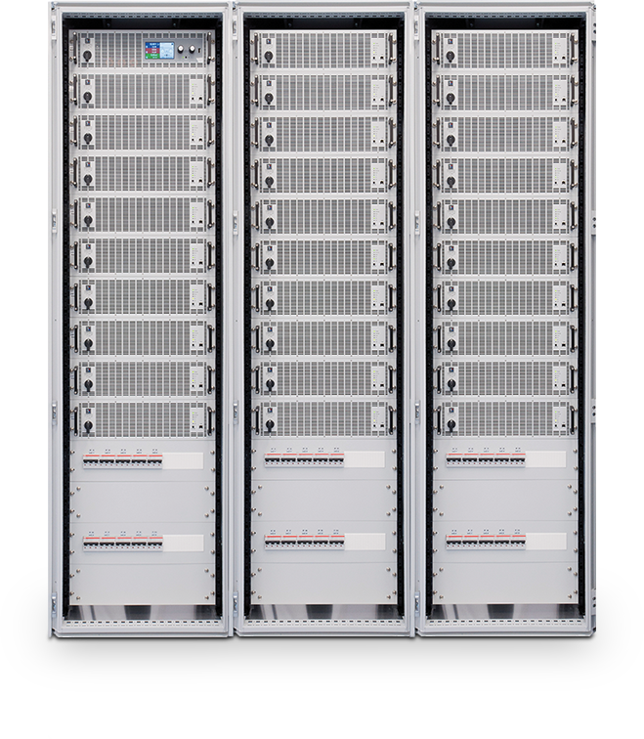
SystemS & Powerracks
19“-cabinet systems
For high-power sources and electronic loads
In block format, with standardised power and back-up modules
Modular construction, available as unidirectional source, unidirectional load (conventional or regenerative) or as a combination of source and load (bi-directional)
Multi channel and ability to operate in parallel (master-slave)
Selectable standard conformity: EN60950 (IT facilities) or EN 60204-1 (safety for machines)

Slide 18
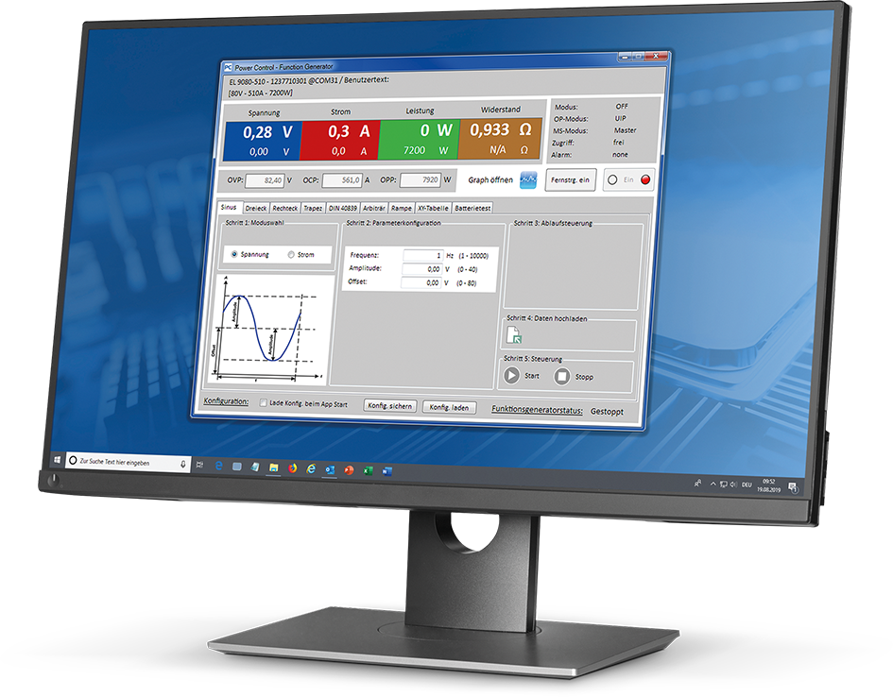
EA POWER CONTROL
Versatile Software with many functions
Remote Control of up to 20 devices
Additional functions such as sequencing and logging
Function generator, software update
PV Array and Fuel Cell Simulation
Labiew VI’s, Microsoft IVI drivers and dbc files for easy system integration

Slide 19
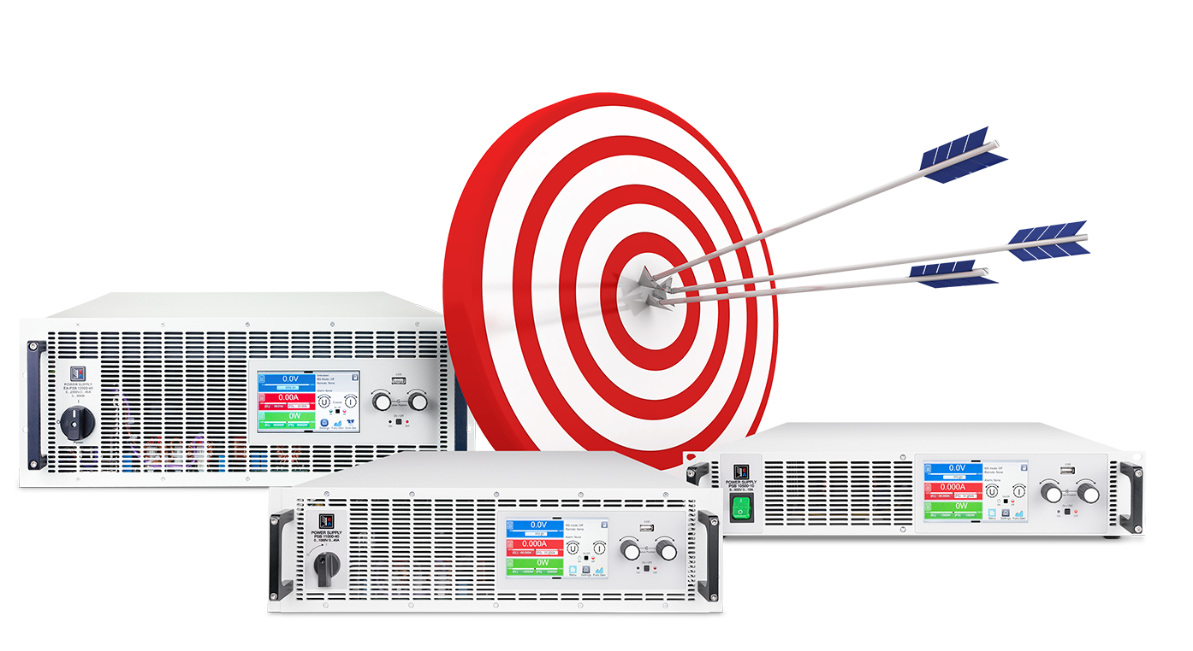
EA hits the mark
Programmable Bidirectional Power Supplies for Testing HV and LV Automotive Equipment

Slide 20

Yes to EA-10000 series
Largest product variety. Extended performance range. Simple and efficient.
Yes to more choice with more than 180 DC power supplies and electronic loads: programmable, bidirectional, regenerative
Yes to extended power ranges: From 600 W up to 30 kW programmable output power, from 6 A up to 1000 A output current, and from 10 V up to 2000 V output voltage
Yes to energy recovery
greater than 96 % efficiency
Yes to safe parallel connection of up to 64 devices in the EA-Power Racks
Yes to efficient applications with autoranging and built-in function generator
Yes to easy handling
with uniform devices and
many interfaces to
PCs and PLCs

Slide 21


Slide 22

Q & A
Thank You!

